Slide 2
Health Care Reform
April 29, 2017
Michael C. Huntington MD
Notes:
50,000 Americans die each month, 500 Oregonians each month
27 Linn-Benton residents/month
As a result of unaffordable health insurance, click 1 77,500 Americans are bankrupted each month (click 2 775 Oregonians, click 3 40 Linn-Benton residents).

Slide 3
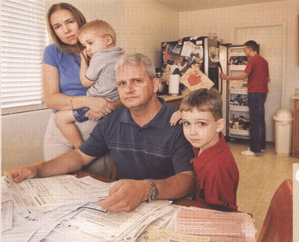
1/3 of Americans Can’t Pay Medical Bills +/- “Insurance” Kaiser Family Foundation 2015
Monthly Bankruptcies: 775 Oregonians, 35 Linn-Benton
(Interpolated from national figures and reference below)
Source: Himmelstein et al. Am J Med, Aug. 2009
and extrapolated from 2011 census data
Notes:
As a result of unaffordable health insurance, click 1 77,500 Americans are bankrupted each month (click 2 775 Oregonians, click 3 40 Linn-Benton residents).
We can do better than this.

Slide 4
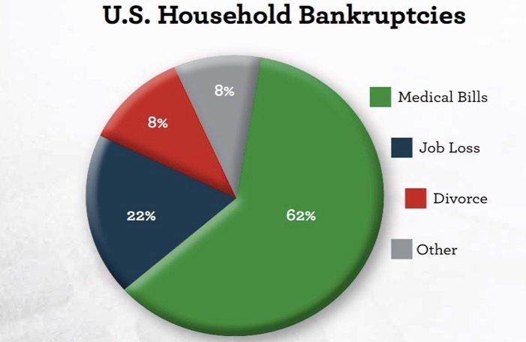
The American Journal of Medicine (2011) 124, 224-228

Slide 5
1/3 Americans Avoid Medical Care Gallup Poll 2015
U.S. is # 1
in cost…
…#19 of 19 nations in preventing death from treatable illness
Commonwealth Fund
June 2008
Monthly Deaths: 40 Oregonians, 2 Linn-Benton
(Interpolated from national figures and reference below)
Wilper et al. American Journal of Public Health | December 2009, Vol 99, No. 12; 2011 census
Notes:
As a result of unaffordable insurance, click 1 4,000 Americans die each month, click 2(40 Oregonians, click 3 2 Linn and Benton County residents). The US is lowest of 16 developed nations when it comes to preventing death from treatable illness.
We can do better than this.
Wilper et al. American Journal of Public Health | December 2009, Vol 99, No. 12, interpolated to 2012 Oregon population.

Slide 6
ONE
ACETAMINOPHEN
TABLET
COSTS 1.5¢
YOUR HOSPITAL
MARKS IT UP
10,000%
Notes:
you may have seen this issue of time magazine just a year ago almost fully devoted to describing exceptionally high cost of health care in this country. That cost is the prime reason that about a third of our population is excluded from care and places our entire population and its economy in jeopardy. Does the ACA and Cover Oregon decrease overall cost? No. The Center for Medicare and Medicaid Services (CMS) projects a 13% increase in administrative costs from 2013 to 2014 due to the administrative complexity of the ACA.
Our system is uniquely expensive for another reason. We are inundated with advertisements and courted with technology and pharmaceuticals. We are offered what might appear to be the best and latest treatment, but 30% of our medical treatments now are either ineffective or even dangerous to us. By overusing technology we create risk for ourselves, high cost to the system, and diversion of money from services that can produce better care for more people at less cost. The ACA, Cover Oregon will have little effect on this phenomenon.

Slide 7
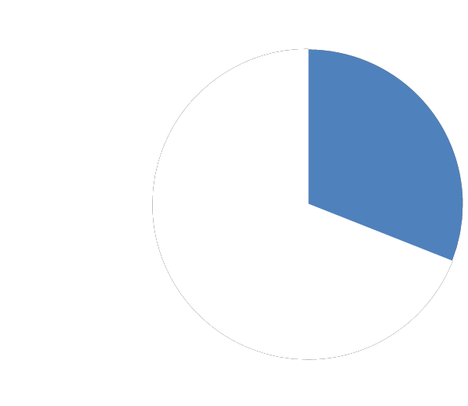
31% Overhead
31%
69%
Administrative
Costs
Clinical
Care
Woolhandler, et al, New England Journal of Medicine, August 2003
& Int. Jrnl. Of Hlth. Services, 2004
Notes:
Finally x the administrative costs of dealing with x hundreds of insurance companies and their plans x and all of the eligibilities and exclusions naturally x result in high administrative costs and will not go away x under the ACA and Cover Oregon. In x the US we have a 31% administrative overhead x including not just the usually quoted administrative costs x to insurance companies or governments, but also the costs of dealing with multiple insurances to employers, hospitals, nursing homes, practitioners, and home care agencies.

Slide 8
Annual premiums and out-of-pocket
$10,000/person $23,000/family
Center for MediCare and MediCaid Svcs, Milliman Index 2015
Notes:
Finally x the administrative costs of dealing with x hundreds of insurance companies and their plans x and all of the eligibilities and exclusions naturally x result in high administrative costs and will not go away x under the ACA and Cover Oregon. In x the US we have a 31% administrative overhead x including not just the usually quoted administrative costs x to insurance companies or governments, but also the costs of dealing with multiple insurances to employers, hospitals, nursing homes, practitioners, and home care agencies.

Slide 9
Rising tide of administrators swamps American health care
3000%
2500%
2000%
1500%
1000%
500%
0
Growth Since 1970
1970 | 1980 | 1990 | 2000 | 2010
Physicians
Administrators
Data updated through 2013
Source: Bureau of Labor Statistics; NCHS; Himmelstein/Woolhandler analysis of CPS
Notes:
Bureau of Labor Statistics, Occupational Employment Statistics, at bls.org.

Slide 10
Notes:
The gap between healthcare costs and GDP continues to widen – this is undermining our capacity to compete globally.

Slide 11
Notes:
The most expensive healthcare system in the World for businesses trying to compete.

Slide 12
Competitive Markets Sift and Sort
Incentive is to Avoid, not Provide Care
70% Rule: 70% of costs are generated by the 10% highest risk people
Cherry pick
Lemon drop
Avoid the 10%
Notes:
The distribution of spending is from http://www.nihcm.org/pdf/DataBrief3%20Final.pdf and http://www.ahrq.gov/research/findings/factsheets/costs/expriach/index.html

Slide 13
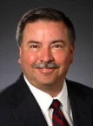
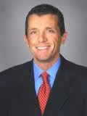
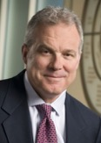
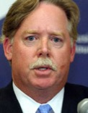
Good Business Leaders, Wrong Business 2012 figures
Angela Braly, WellPoint
$21 million
George Paz, ExpressScripts $59 million
David Cordony Cigna
$13 million
Steven Hemsley, United Health Group, $49 million
Mark Bartolini, Aetna,
$49 million
Michael McCallister Humana
$7 million
Better care for more people at less cost?
Notes:
Salaries as reported in the New York Times.

Slide 14
Good Business
Health Insurers Making Record Profits as Many Postpone Care
NYTimes May 13, 2011
Cigna, Humana CEOs earn millions in pay jumps
http://www.fiercehealthpayer.com/story/cigna-humana-ceos-earn-millions-pay-jumps/2012-03-07
Cigna profit exceeds expectations; lower costs help
Reuters, August 1, 2013

Slide 15
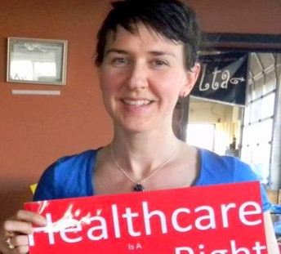
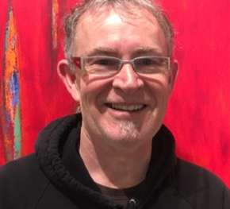
…Bad Public Policy
Notes:
1. Kelly Howard, a young mother of two in Lincoln City who before the ACA was enacted paid $451 a month for a $15,000 deductible plan for her family of three ($5,000 each). She would have been counted as insured by statisticians, but she was seriously under-insured and could not afford health care. After the ACA was enacted she was able to purchase a $2,000 deductible plan for $291/month and was protected by a $12,000 cap on out-of-pocket expenses.
2. Sally Conklin, a local veterinarian who faced eviction from her farm in Monroe because of health care costs.
3. Tracy MacEwan, artist and former teacher, could not afford health care insurance but his income disqualified him for Medicaid. He suffered a stroke in 2012 from undiagnosed hypertension, was in an ICU for 30 days, generated medical bills of $100,000 - $200,000 in medical bills, became wheel-chair bound and dependent on the state for aid. It was 2015 before he was able to regain independent living.
Q: Could this gentleman really “not afford health care” or was this just a choice that he made?
A: He like many in our communities, maybe even a neighbor, friend, or family member, are having to choose between healthcare and other necessities of life such as food, shelter, and educational opportunity.
Q: How can you be sure that access to treatment would have made a difference for this gentleman?
A: Early diagnosis and control of life-threatening chronic diseases such as this gentleman had is much more likely when the patient has healthcare insurance or other access to qualified health care personnel.
Q: How representative are these stories of our healthcare system?
A: Very representative. As is now the case even under the ACA. Most of the uninsured and underinsured are employed and 80% are US citizens. “Obamacare leaves millions uninsured. Here’s who they are. ” Sarah Kliff Washington Post, June 7, 2013
It’s tempting to think that this cannot be happening to Americans who are “doing all the right things”. The American ideal of innocent until proven guilty is not really the default response to hearing stories like this. More likely we will try to separate ourselves from the victims of our health care system by supposing that person somehow brought the unfortunate incident upon him- or herself. We don’t want to imagine a world which unfair things happen to innocent people. But these things do happen, are happening, and… can be prevented… if we think and act wisely and compassionately and even out of self-interest.
Q: Can’t most people get care through Medicaid or County Health Departments?
A: No, inadequate capacity, lottery system started in 2008. Income of > $26,951 disqualifies family and yet reliable insurance costs $18,000. That leaves less than $9,000/yr or $750/month to live on. So families go without health insurance and health care.
That homeless person who needs healthcare may be the son of a Marine who died on Iwo Jima. That disheveled looking person over there may have lost a son in Afghanistan. In other words, it is impossible to choose who “deserves” health care and who does not.
Not shown is a farmer from Spokane who has many friends who would love to start their own farming business but don’t dare leave their otherwise unrewarding job with a company that still happens to provide healthcare insurance.
We can do better than this.

Slide 16
Notes:
U.S. is in last place in overall ranking of health care

Slide 17
Notes:
The ACA, Cover Oregon, and the CCOs will not relieve this chaos or prevent this eclipse. Other countries have one half to a third of our administrative costs because they have a s

Slide 19
Notes:
Single-payer is the recognized international standard in healthcare system structure for modern industrialized economies.

Slide 20
Relieves business owners from the burden of health care management
Notes:
Universal care relieves employers of all administrative responsibilities. Employers do not need to manage funds, determine benefits, or pay providers.

Slide 21
Keeps health care costs predictable
Notes:
Universal publicly funded health care allows every individual and business owner to know their share of costs as a taxpayer. These costs do not change regardless of health, family size, or employment status.

Slide 22
Keeps employees, full- and part-time, healthier and more productive
Notes:
By removing deductibles and co-pays, universal care encourages employees to seek health care early. Employees stay healthier and more productive, reducing sick time costs.

Slide 23
Employees will not switch jobs to receive health care benefits
Notes:
Universal care means every employee gets the same comprehensive benefits regardless of employer. Entrepreneurs can start a new business and retain health care access for themselves, their families, and new employees. Employers do not need to split full-time positions into multiple part time positions to reduce health care costs.

Slide 24
Health care benefits no longer a drag on business competitiveness
Notes:
All individuals and businesses will pay their fair share for providing universal health care. Oregon companies will have a strong competitive advantage over states with employer based health care and will be better able to compete internationally with countries already providing universal care.

Slide 25
Health care becomes independent of labor-management negotiations
Notes:
Benefits are determined by the single payer agency, not by individual labor-management contracts.

Slide 26
Removes the costs of providing care for retired and disabled employees
Notes:
A universal health care system provides everyone in Oregon with the same benefits, regardless of age, employment status or disability, relieving businesses of the burden of paying for retiree health plans.

Slide 27
Mid-Valley Healthcare Advocates 4th Mondays 7-9 p.m. Unitarian Fellowship 2945 NW Circle www.mvhca.org
Notes:
If you want to learn more about how you or your business can get the most benefit out of the Affordable Care Act or if you want to learn more about single-payer healthcare I invite you to contact me or Cheryl and come to Mid-Valley Healthcare Advocates which meets every fourth Monday night 7 PM to 9 PM at the Unitarian Fellowship on Northwest Circle.

Slide 28
Physicians for a National Health Program 3rd Mondays 5:30-7:00 p.m. Mike Huntington 541-75-5635 www.mvhca.org
Notes:
If you want to learn more about how you or your business can get the most benefit out of the Affordable Care Act or if you want to learn more about single-payer healthcare I invite you to contact me or Cheryl and come to Mid-Valley Healthcare Advocates which meets every fourth Monday night 7 PM to 9 PM at the Unitarian Fellowship on Northwest Circle.

Slide 29
Main Street Alliance of Oregon Alberta St Suite 202 619 SW 11th St. Portland, OR 97205 971-634-0009 www.oregon.mainstreetalliance.org
Notes:
. I encourage you also to invite a representative of Main Street Alliance to speak to your group about not only healthcare but about other cooperative benefits Main Street Alliance provides for business owners around the state.

Slide 30
Health Care For All Oregon 1433 SE 122nd Ave., Portland, OR 97233 503-206-6709 www.hcao.org
Notes:
Mid-Valley Healthcare Advocates and Main Street alliance are two of 90 organizations around the state that belong to Healthcare for All Oregon. The goal of Health Care for All Oregon is to create a statewide movement that will support the passage of a publicly funded single-payer healthcare plan for the state that will provide the best care for the most people at the least cost. I invite you to become part of this movement in any way that you can, whether individually or through one of these three organizations.

Slide 31
Single-Payer Health Care Is Seeing Record Support in Congress
Sunday, April 16, 2017 By Michael Corcoran, Truthout | Report
Notes:
John Conyers' Medicare for All bill (HR 676), which he has introduced in each Congress since 2003, has seen a recent surge of new cosponsors -- 32 since March 8 and nine on April 3 alone. As of this writing there are 93 co-signers (and counting), representing more than 48 percent of the Democratic Caucus. This is the highest number of cosponsors ever, both in terms of members and as a percentage of the House Democratic Caucus. The count is up from just 62 cosigners -- 33 percent of Democrats -- in the last Congress, and an average of 37 percent since the bill was first introduced in 2003 (see chart).

Slide 32
Extra slides follow
Current slides are also available online from www.pnhp.org. See link half way down left column.
Password to the slides is the last name of the PNHP president which for 2017-18 is “Paris”.
It would be kind and rewarding for PNHP and you if you joined PNHP and sent money to them to support the research they do.

Slide 33
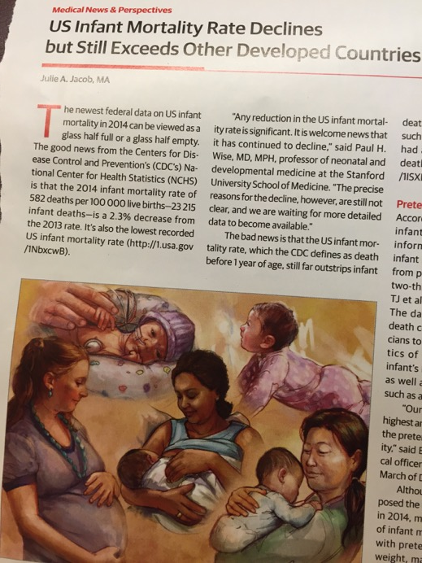
JAMA February 2, 2016 Vol. 315, # 5
Notes:
Finally x the administrative costs of dealing with x hundreds of insurance companies and their plans x and all of the eligibilities and exclusions naturally x result in high administrative costs and will not go away x under the ACA and Cover Oregon. In x the US we have a 31% administrative overhead x including not just the usually quoted administrative costs x to insurance companies or governments, but also the costs of dealing with multiple insurances to employers, hospitals, nursing homes, practitioners, and home care agencies.

Slide 34
Notes:
Medicare has about 3% administration expense.

Slide 35
Universal, Comprehensive, Publicly Funded Health Care
OPTIONS FOR THE FUTURE
9/16/15

Slide 36
WHY WOULD WE WANT TO DESIGN A UNIVERSAL HEALTH CARE SYSTEM FOR OREGON? WHAT ARE SOME OF THE PROBLEMS WITH OUR CURRENT HEALTH CARE INDUSTRY?

Slide 37
Why simplify health care billing administration?
3000%
2500%
2000%
1500%
1000%
500%
0
1970 | 1980 | 1990 | 2000 | 2010
Growth Since 1970
Physicians
Administrators

Slide 38
The large increase in health care costs has created hardships, and sometimes disasters, for individuals and families
Due to lack of affordable health care, each year
600 Oregonians die
8,000 go bankrupt

Slide 39
Households lacking assets to pay deductibles
80%
mid range deductibles
70%
68%
60%
higher
55%
deductibles
51%
50%
households with
insufficient assets
40%
35%
30%
25%
24%
20%
19%
11%
10%
0%
All Households
100% to 250% 250% to 400% over 400%
percent of Federal Poverty Level

Slide 40
Prescription Drug Prices and
Administrative Costs Have Risen Most
2000%
Health Care
cost
increase
1500%
1000%
1980
to 2005
500%
0%
Hospital care Physicians | Nursing | Prescription | Administration | CPI | Wages | Per-capita
services | homes and | drugs | of private |  |  | income
 | home health |  | health
 | care |  | insurance

Slide 41
Learn from other countries –
most have higher approval
60%
Proportion saying health care system works
well
40%
20%
0%
UK
USA
Australia
Canada
France
Germany
Norway
Sweden
Netherlands
Switzerland
New Zealand

Slide 42
Learn from other countries –
most have better results
86
84
Female Life Expectancy at Birth
Turkey
Mexico
Hungary Slovak Republic
Chile
Czech Republic
Poland United States
Estonia Denmark Ireland
New Zealand
Greece Netherlands United Kingdom
Belgium Germany Canada
Slovenia
Israel Luxembourg
Norway Finland Sweden
Austria
Portugal Iceland Australia
Korea Switzerland
Italy Spain France Japan
82
80
Other markers of results are similar
78
76
74

Slide 43
Universal health care adoption – year & country
States pursuing single- payer health care
*bill in current session
The compelling advantages of Universal Health Care are moving the U.S. to join every other developed country in the world soon
State
California
Illinois*
Maine
Massachusetts*
Minnesota
Missouri
New Hampshire
New Mexico
New York*
North Carolina
Ohio*
Oregon*
Pennsylvania*
Rhode Island*
South Carolina*
Vermont*
Washington*

Slide 44
Learn from other countries –
all spend less
20
15
Estonia
Turkey Mexico Luxembourg
Poland Korea
Czech Republic
Chile Israel Hungary
Slovak Republic
Slovenia Ireland Australia Finland Iceland Greece
Italy Norway Spain
United Kingdom
Sweden Japan Portugal
New Zealand ¹
Belgium ¹ Austria Denmark Switzerland
Canada Germany France Netherlands United States
Health Care Spending as %
of GDP
10
5
0

Slide 45
Steps to continue improving health care in Oregon
Begin negotiations for federal waivers, certifications, and permissions
Refine the Regional Planning Board concept, or another way
towards regional equity
Design a fair and sufficiently funded tax structure to finance a universal system
Increase awareness among Oregonians of future options for improved health care

Slide 46
Health care costs have been
rising rapidly for a long time
19%
18%
Health Care Costs As Share Of Gross
State Product
17%
16%
15%
14%
13%
12%
11%
10%
1991
1994
1997
2000
2003
2006
2009
2012
2015
2018
2021
2024

Slide 47
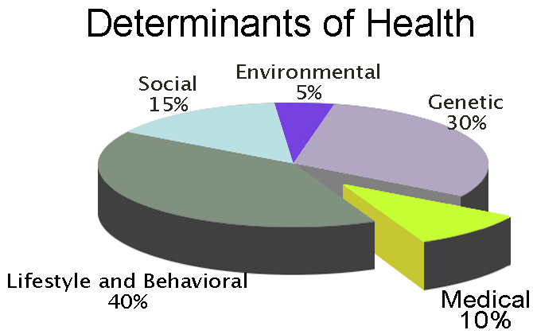
From Competition and Confiscation to Cooperation and Mobilization

