Slide 1
Everyone In, Nobody Out
A movement to gain universal, comprehensive, publicly funded health care

Slide 2
Overview
Do we really have the best health care system in the world?
Isn’t everyone covered now with affordable health insurance after passage of the ACA?
What could a universal, publicly funded health system look like?
How do we get there?
What can you do to help?

Slide 3
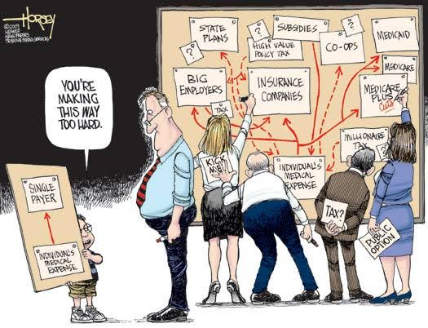
American Health Care Financing

Slide 4
The best health care system?
The Most Expensive in the Developed World

Slide 5
The most expensive
Notes:
http://www.oecd.org/els/health-systems/oecdhealthdata2013-frequentlyrequesteddata.htm November 2013 update
<number>

Slide 6
Health care costs predicted
to continue rising

Slide 7
Why is it so expensive?
Health Insurers Making Record Profits as Many Postpone Care
NYTimes May 13, 2011
Cigna, Humana CEOs earn millions in pay jumps
http://www.fiercehealthpayer.com/story/cigna-humana-ceos-earn-millions-pay-jumps/2012-03-07
Cigna profit exceeds expectations; lower costs help
Reuters, August 1, 2013

Slide 8
Rising administrative costs
3000%
2500%
2000%
1500%
1000%
500%
0
Growth Since 1970
1970 | 1980 | 1990 | 2000 | 2010
Physicians
Administrators
Data updated through 2013
Source: Bureau of Labor Statistics; NCHS; Himmelstein/Woolhandler analysis of CPS
Notes:
Bureau of Labor Statistics, Occupational Employment Statistics, at bls.org.
<number>

Slide 9
31% Overhead
31%
69%
Administrative
Costs
Clinical
Care
Woolhandler, et al, New England Journal of Medicine, August 2003
& Int. Jrnl. Of Hlth. Services, 2004
Notes:
<number>
Finally x the administrative costs of dealing with x hundreds of insurance companies and their plans x and all of the eligibilities and exclusions naturally x result in high administrative costs and will not go away x under the ACA and Cover Oregon. In x the US we have a 31% administrative overhead x including not just the usually quoted administrative costs x to insurance companies or governments, but also the costs of dealing with multiple insurances to employers, hospitals, nursing homes, practitioners, and home care agencies.

Slide 10
Why is it so expensive: Rising drug prices
Notes:
http://www.commonwealthfund.org/usr_doc/Davis_slowinggrowthUShltcareexpenditureswhatareoptions_989.pdf
These are quality controlled price indices from the Bureau of Labor Statistics
<number>

Slide 11
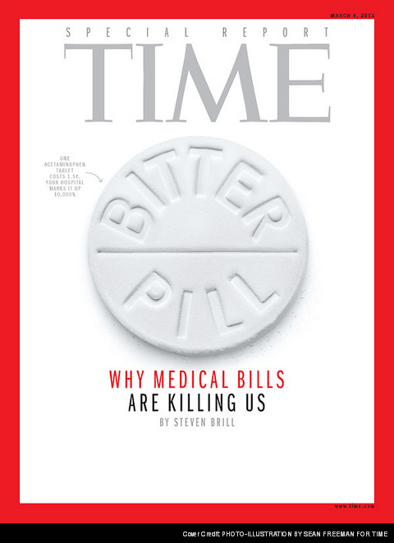
ONE
ACETAMINOPHEN
TABLET
COSTS 1.5¢
YOUR HOSPITAL
MARKS IT UP
10,000%
Notes:
you may have seen this issue of time magazine just a year ago almost fully devoted to describing exceptionally high cost of health care in this country. That cost is the prime reason that about a third of our population is excluded from care and places our entire population and its economy in jeopardy. Does the ACA and Cover Oregon decrease overall cost? No. The Center for Medicare and Medicaid Services (CMS) projects a 13% increase in administrative costs from 2013 to 2014 due to the administrative complexity of the ACA.
Our system is uniquely expensive for another reason. We are inundated with advertisements and courted with technology and pharmaceuticals. We are offered what might appear to be the best and latest treatment, but 30% of our medical treatments now are either ineffective or even dangerous to us. By overusing technology we create risk for ourselves, high cost to the system, and diversion of money from services that can produce better care for more people at less cost. The ACA, Cover Oregon will have little effect on this phenomenon.
<number>

Slide 12
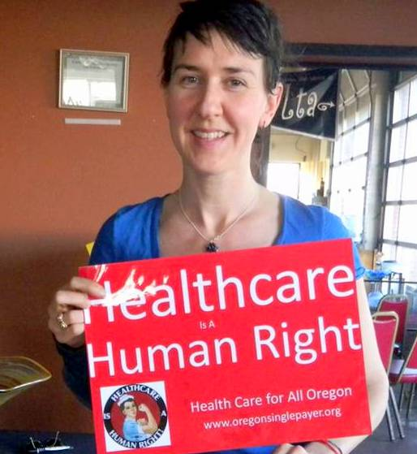
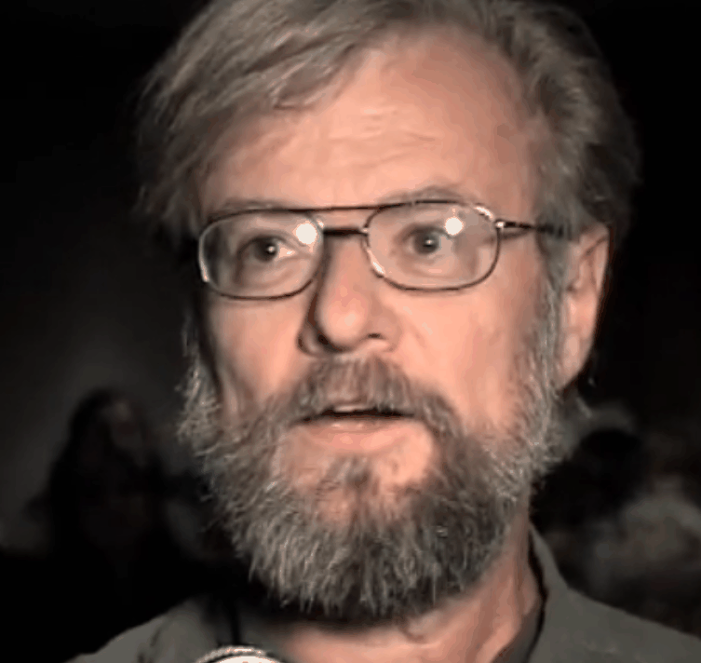
…Bad Public Policy
Notes:
I’ll show you three people representing those thousands of people. click 1 First, is Sally Conklin, a local veterinarian who faced eviction from her farm in Monroe because of health care costs.
click 2 Next is Kelly Howard, a young mother of two in Lincoln City who pays $451 a month for a $15,000 deductible plan for her family of three ($5,000 each). She would be counted as insured by statisticians, but she is seriously under insured and cannot afford health care. Her $451/mo more or less serves as ransom for her house so she won’t lose it if she gets seriously ill. She has a middle-aged friend who two years ago because of lack of insurance became wheel-chair bound and dependent on the state for aid after he suffered a stroke from undiagnosed hypertension.
Q: Could this gentleman really “not afford health care” or was this just a choice that he made?
A: He like many in our communities, maybe even a neighbor, friend, or family member, are having to choose between healthcare and other necessities of life such as food, shelter, and educational opportunity.
Q: How can you be sure that access to treatment would have made a difference for this gentleman?
A: Early diagnosis and control of life-threatening chronic diseases such as this gentleman had is much more likely when the patient has healthcare insurance or other access to qualified health care personnel.
Q: How representative are these stories of our healthcare system?
A: Very representative. As is now the case and will be under the ACA. Most of the uninsured and underinsured are employed and 80% are US citizens. “Obamacare leaves millions uninsured. Here’s who they are. ” Sarah Kliff Washington Post, June 7, 2013
It’s tempting to think that this cannot be happening to Americans who are “doing all the right things”. The American ideal of innocent until proven guilty is not really the default response to hearing stories like this. More likely we will try to separate ourselves from the victims of our health care system by supposing that person somehow brought the unfortunate incident upon him- or herself. We don’t want to imagine a world which unfair things happen to innocent people. But these things do happen, are happening, and… can be prevented… if we think and act wisely and compassionately and even out of self-interest.
Q: Can’t most people get care through Medicaid or County Health Departments?
A: No, inadequate capacity, lottery system started in 2008. Income of > $26,951 disqualifies family and yet reliable insurance costs $18,000. That leaves less than $9,000/yr or $750/month to live on. So families go without health insurance and health care.
That homeless person who needs healthcare may be the son of a Marine who died on Iwo Jima. That disheveled looking person over there may have lost a son in Afghanistan. In other words, it is impossible to choose who “deserves” health care and who does not.
click 3 Next is a farmer from Spokane who has many friends who would love to start their own farming business but don’t dare leave their otherwise unrewarding job with a company that still happens to provide healthcare insurance.
We can do better than this.
Extra verbiage as needed:
Sally Conklin feeds an apple to Bella, her 32-year-old mule, on Thursday afternoon. Conklin is worried about what will happen to Bella when she is forced to move from the 7.75-acre minifarm she has owned for the past 36 years. (Andy Cripe/Gazette-Times)
*Single mother slide: This is a single mother at her glass-blowing studio in Lincoln city. She pays $400 a month for a $16,000 deductible health insurance plan for her family of three. Her policy may keep her from losing her house because of medical bills but this policy does not allow her to afford healthcare. If she burns herself at work, she may not be able to afford the medical care that would allow her to return to work and preserve her independence and dignity. She well knows this because one of her artist friends lost his freedom and independence following a stroke from high blood pressure, an affliction he did not know about because he could not afford insurance.
<number>

Slide 13
Annual premiums and out-of-pocket
$10,000/person $23,000/family
Center for MediCare and MediCaid Svcs, Milliman Index 2015
Notes:
<number>
Finally x the administrative costs of dealing with x hundreds of insurance companies and their plans x and all of the eligibilities and exclusions naturally x result in high administrative costs and will not go away x under the ACA and Cover Oregon. In x the US we have a 31% administrative overhead x including not just the usually quoted administrative costs x to insurance companies or governments, but also the costs of dealing with multiple insurances to employers, hospitals, nursing homes, practitioners, and home care agencies.

Slide 14
Notes:
The ACA, Cover Oregon, and the CCOs will not relieve this chaos or prevent this eclipse. Other countries have one half to a third of our administrative costs because they have a s
<number>

Slide 15
Even with the Affordable
Care Act . . . .
The large increase in health care costs has created hardships, and sometimes disasters, for individuals and families
Due to lack of affordable health care, each year
600 Oregonians die
8,000 go bankrupt

Slide 16
A Case Study in Lane County, Oregon
Population – 356,000
800 personal bankruptcies in 2014, with 72% related to medical debt AND 10 biggest creditors all medical businesses.
Non-profit PeaceHealth increased profits from $39.6 million in 2013 to $97.4 Million in 2014.
PeaceHealth used aggressive collection tactics against Hollie Murphie, who was so underinsured with her employee plan that she was left with thousands of dollars of medical Bills. Garnished her wages to cover cost of her surgery.
Notes:
<number>

Slide 17
The best health care system?
Shorter Lives, Poorer Health, lower satisfaction, less access to care

Slide 18
Life Expectancy at Birth,
Affluent Countries
US life expectancy lower even for those with insurance!
Notes:
http://www.commonwealthfund.org/publications/fund-reports/2013/nov/international-profiles-of-health-care-systems
US rate for insured and uninsured estimated on assumption that mortality rate for uninsured is 60% higher than for insured.
<number>

Slide 19
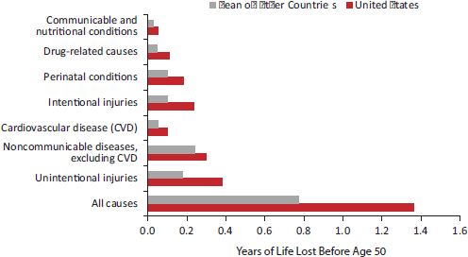
Years of Lost Life Before Age 50
in Men 2006-2008
National Academies Press (2013) Health in International Perspective: Shorter
Lives, Poorer Health

Slide 20
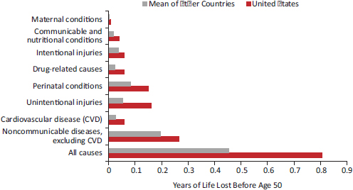
Years of Lost Life Before Age 50
in Women 2006-2008
National Academies Press (2013) Health in International Perspective: Shorter
Lives, Poorer Health

Slide 21
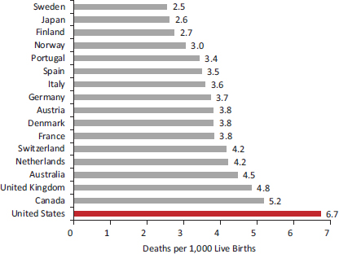
Infant Mortality Rates
in 17 countries,2005-2009
National Academies Press (2013) Health in International Perspective: Shorter
Lives, Poorer Health

Slide 22
Poorer health,
using many indicators
Highest prevalence of diabetes in young adults age 15-44 of any developed country
Americans <50 have the highest incidence of heart attack, stroke, cancer, diabetes and activity limitations in comparison with 10 other developed countries
National Academies Press (2013) Health in International Perspective: Shorter
Lives, Poorer Health
Notes:
<number>

Slide 23
Access To Health Care
Americans have the most problems – even those with insurance
USA Uninsured
Cost-Related Access Problem
USA Insured
Did not see a doctor when sick or did not get recommended care because of cost, did not fill Rx or skipped doses because of cost
Commonwealth Fund data reported in Schoen, C et al.Health Affairs 32,No.12 (2013):2205-2215
Notes:
http://www.commonwealthfund.org/publications/fund-reports/2013/nov/international-profiles-of-health-care-systems
<number>

Slide 24
Satisfaction with health system
Notes:
http://www.commonwealthfund.org/publications/fund-reports/2013/nov/international-profiles-of-health-care-systems
<number>

Slide 25
What could a universal, publicly funded health system look like?
Federal Legislation AND State by state initiatives

Slide 26
Proposed Federal Legislation:
Universal Converage
Single Payer Bill
YES. Everyone covered automatically at birth
Afforcable Care Act
NO. 30 million will still be uninsured in 2022 and tens of millions will remain underinsured

Slide 27
Proposed Federal Legislation:
Full Range of Benefits
Single Payer Bill
Yes. Coverage for all medically necessary services.
Affordable Care Act
No. Insurers continue to strip down policies and increase patients’ co-payments and deductibles

Slide 28
Proposed Federal Legislation:
Savings
Single Payer Bill
Yes. Redirects $400 billion in administrative waste to care; no net increase in health spending.
Afforcable Care Act
No. Increases health spending by about $1.1 trillion over 10 years. Adds further layers of administrative bloat to our health system through the introduction of state-based exchanges

Slide 29
Proposed Federal Legislation:
Cost control/sustainability
Single Payer Bill
Large-scale cost controls (negotiated fee schedule with physicians, bulk purchasing of drugs, hospital budgeting, capital planning, etc) ensure that benefits are sustainable over long term
Afforcable Care Act
No. Preserves a fragmented system incapable of controlling costs. Gains in coverage are erased by rising out-of-pocket expenses, bureaucratic waste and profiteering by private insurers and Big Pharma

Slide 30
Proposed Federal Legislation:
Choice of Doctor and Hospital
Single Payer Bill
Yes. Patients will be allowed free choice of their doctor and hospital
Afforcable Care Act
No. Insurance companies continue to deny and limit care and to maintain restrictive networks

Slide 31
Proposed Federal Legislation:
Progressive Financing
Single Payer Bill
Yes. Premiums and out-of-pocket costs are replaced with progressive income and wealth taxes. 95% of Americans would pay less for care than they do now.
Afforcable Care Act
No. Continues the unfair financing of health care whereby costs are disproportionately paid by middle and low-income Americans and those families facing acute or chronic illness.

Slide 32
Basic Premise

Slide 33
Health Care for All
Oregon Act (SB 631)
Who is covered?
All persons residing or working in Oregon
All people are currently covered for acute emergency room care (expensive) – legal, ethical, & moral requirement
Bill would broaden coverage – could prevent many emergency room visits & better maintain health

Slide 34
Theme of SB 631
Simplify administration
cover all residents (universal)
for all medically necessary services (comprehensive)
single-payer
same payments for same services
no copays and deductibles

Slide 35
Theme of SB 631
Flexible payment systems, tailored by provider, to best meet needs of providers and system
global budgets
fee for service
other transparent & fair systems as needed

Slide 36
Administrative simplicity generally leads to equity
All residents covered equally
All medically necessary services covered
Same payments for same services
Equity for providers
Equity for patients
Now – private insurers, Medicare, Oregon Health Plan, individuals pay differently

Slide 37
How do we get there?

Slide 38
HCAO
A Movement committed to the belief that health care is a human right
Working to ensure every person in Oregon has access to an equitable, afford- able, comprehensive, high-quality, publicly funded universal health care system—a system that will save lives and save money at the same time.
Notes:
<number>

Slide 39
The growth of a movement
2012-2015
Local action groups in 14 counties
120 orgnizational members with more joining every month (including Nurses for Single Payer and ONA)
18000 supporters
Contributions of over $500,000 from more than 800 donors
1200 Universal Care advocates participated in lobby day February 2015, meeting with 70 legislators

Slide 40
HCAO Actions
2012-2015
\
Testified to Oregon Senate Health Care Committee 2015
Completed 2 professional voter polls—one to determine support for a ballot measure on publicly financed health care and a 2nd on amending the Oregon Constitution to declare that Health Care is a Human Right.
Led efforts to obtain state funding for HB2828, a bill that provides $300,000 to study models for financing a universal health care system in Oregon. Study now being conducted by the Oregon Health Authority

Slide 41
Health Care for All-Oregon
2016-2020
Increase the reach of our statewide educational programs􏰁
Increase our base of support on all fronts􏰁
Implement Legislative Strategy
Lobby 2017􏰄 legislature to create a funded work􏰅 group charged with designing a health care system based on the HB 2828 study recommendations.
W􏰇rite a bill with a defined ta􏰈x structure by 2018􏰁
L􏰃obby the legislature to place advisory q􏰉uestions on the 2018 ballot— a way to engage voters on our issues and inform the legislative process prior to voting on a measure in 2020􏰁
L􏰃obby the legislature to refer our plan to the voters for the 2020 ballot in the 201􏰊 or 2020 session􏰁

Slide 42
Health Care for All-Oregon
2016-2020
Increase the reach of our statewide educational programs􏰁
Increase our base of support on all fronts􏰁
Implement Legislative Strategy
Collect signatures to q􏰉ualify an initiative petition supporting publicly funded health care on the 2020 ballot should the legislature fail to refer an appropriate bill to the voters􏰁
Continue wor􏰅k with our allies to educate the public while coordinating with other local, state, and national campaigns all to make universal, publicly funded health care a reality in Oregon.

Slide 43
Nurses for Single Payer
55000 registered nurses in Oregon
Nurses
are the largest and most highly respected health profession
live and work in every community in Oregon
are well known and respected in their communities
understand why the current system isn’t working and what we need to do to fix it

Slide 44
Nurses for Single Payer
Goals
We want 55000 to favor publicly funded, universal care
We want 10000 nurses to agree to:
speak with colleagues, neighbors, friends knowledgably about the need for universal, publicly funded health care
publicly support legislation and ballot initiative
argue against the health insurance lobby and others who will strongly oppose this change

Slide 45
What Can You Do?
Get Involved – NFSP & HCAO
Get informed
Listen for Compelling stories
Engage in Advocacy and Education
Meet your legislator
Participate in the Ballot Initiative process

